Slide 1

MACHINE
INTELLIGENCE
Perceptron
K.S.Srinivas
Department of Computer Science and Engineering

Slide 2

MACHINE INTELLIGENCE
Perceptron
K.S.Srinivas
Department of Computer Science and Engineering

Slide 3
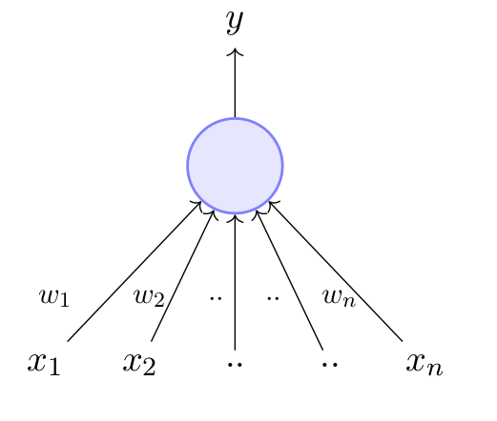
MACHINE INTELLIGENCE
The Perceptron
A perceptron takes a vector of real-valued inputs, calculates a linear combination of these inputs, then outputs 1 if the result is greater than some threshold and -1 otherwise.

Slide 4
MACHINE INTELLIGENCE
The Perceptron
Frank Rosenblatt, an American psychologist, proposed the classical perceptron model (1958)
A more general computational model than McCulloch–Pitts neurons
Main differences: Introduction of numerical weights for inputs and a mechanism for learning these weights
Inputs are no longer limited to boolean values
Refined and carefully analyzed by Minsky and Papert (1969) - their model is referred to as the perceptron model here

Slide 5
MACHINE INTELLIGENCE
The Perceptron
consider this single perceptron, we call w₀ as bias and X₀=1
w₁.....w_{n} are weights associated with inputs x₁...x_{n}.
y is the output
let us try to frame equation for the output y
y
w₀=-θ
x₀=1
w₁
w_{n}
x₁
x_{n}
where w₀ =-θ and x₀=1

Slide 6
MACHINE INTELLIGENCE
The Perceptron
w_{0*}x₀ are known ,hence we can rewrite the equation as
y
w₀=-θ
x₀=1
w₁
w_{n}
x₁
x_{n}
where w₀ =-θ and x₀=1

Slide 7
MACHINE INTELLIGENCE
Simple Example Perceptron
x1 =actor
x2=genre
x3=director
Consider the task of predicting whether we would like a movie or not
Suppose, we base our decision on 3 inputs
Based on our past viewing experience (data), we may give a high weight to Director as compared to the other inputs
y
w₀=-θ
x₀=1
w₁
w₂
w₃
x₁
x₂
x₃
Specifically, even if the actor is not xyz and the genre is not thriller we would still want to cross the threshold θ by assigning a high weight to director
A movie buff may have a very low threshold and may watch any movie irrespective of the genre, actor, director [θ = 0]

Slide 8
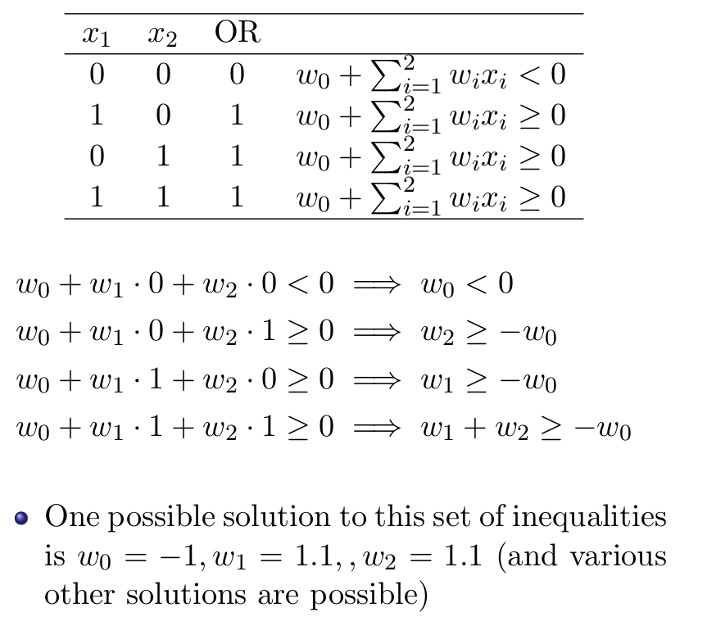
MACHINE INTELLIGENCE
Logical OR learning
consider the truth table of logic OR
and our perceptron equation
let us frame the perceptron eqn for each input
w₀+w₁.0+w₂.0<0 =>w₀<0
w₀+w₁.0+w₂.0<0 =>w₀<0
w₀+w₁.1+w₂.0≥0 =>w₁≥-w₀
w₀+w₁.1+w₂.0≥0 =>w₁≥-w₀
w₀+w₁.0+w₂.1≥0 =>w₂≥-w₀
x2
w₀+w₁.0+w₂.1≥0 =>w₂≥-w₀
w₀+w₁.1+w₂.1≥0 =>w₂+w₁≥-w₀
w₀+w₁.1+w₂.1≥0 =>w₂+w₁≥-w₀
(0,1)
(1,1)
(0,0)
(1,0)
x1

Slide 9
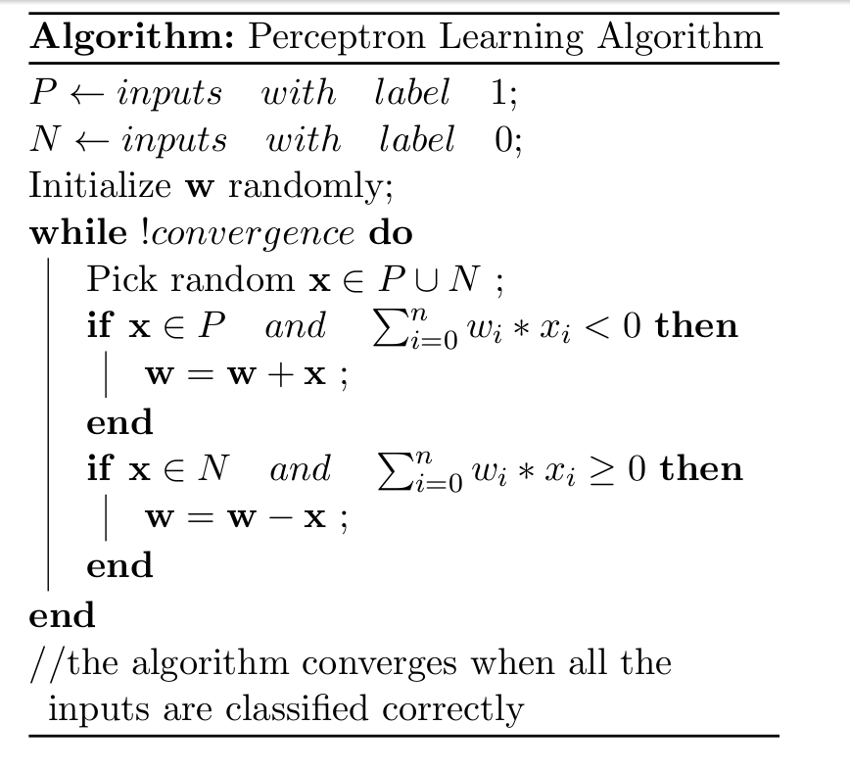
MACHINE INTELLIGENCE
Perceptron Learning Algorithm
we will look at the concept of convergence later

Slide 10
MACHINE INTELLIGENCE
Revisiting the Perceptron Learning Concept
consider two vector w and x
w=[w₀,w₁,.........,w_{n}]
x=[x₀,x₁,.........,x_{n}]
w.x= w^{T}x =∑ w_{i}*x_{i}
we can thus rewrite the perceptron rule as
y=1 if w^{T}x≥0
=0 if w^{T}x<0
we are interested in finding the line w^{T}x=0 which divides the input space into two halves
Every point (x) on this line satisfies the equation w^{T}x=0
let us call the angle between w and any point x as ɑ
what could be value of ɑ ???
ɑ=90
since the vector w is perpendicular to every point on the line it is actually perpendicular to the line itself

Slide 11
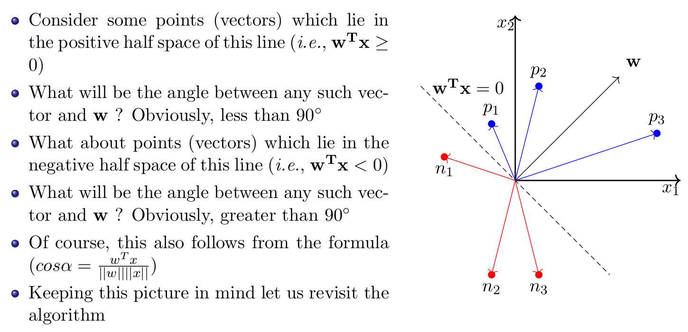
MACHINE INTELLIGENCE
Revisiting the Perceptron Learning Concept

Slide 12
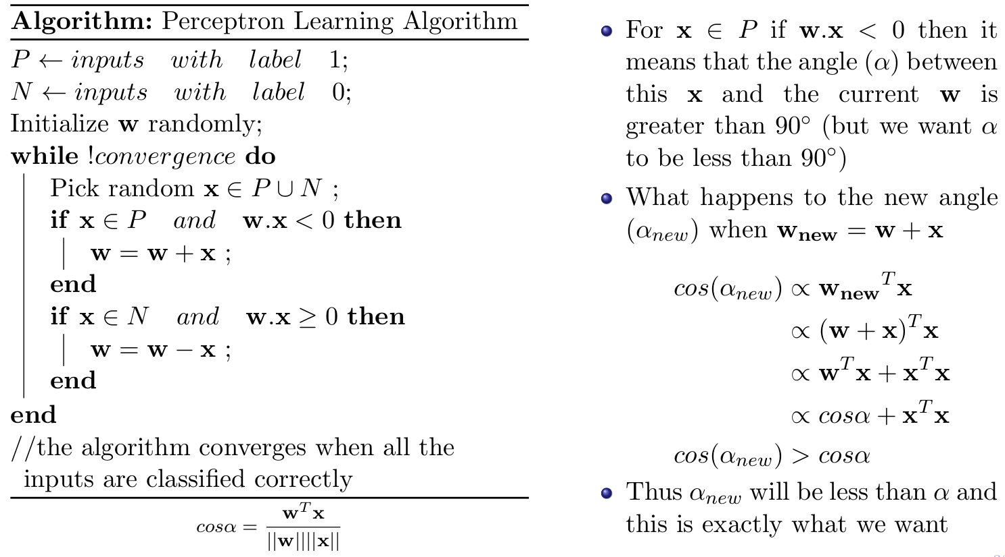
MACHINE INTELLIGENCE
Perceptron Learning Algorithm

Slide 13
MACHINE INTELLIGENCE
The Perceptron learning for Linear Surface
A perceptron is a thresholded linear unit (discrete-valued).
Linear Unit: A linear combination of weighted inputs (real-valued).
Perceptron offer a linear decision surface. This means a single perceptron can easily represent simple Boolean functions like AND, OR,NAND and NOR.
AND: w₀ = -0.8, w₁ = w₂ = 0.5
OR: w₀ = -0.3, w₁ = w₂ = 0.5

Slide 14
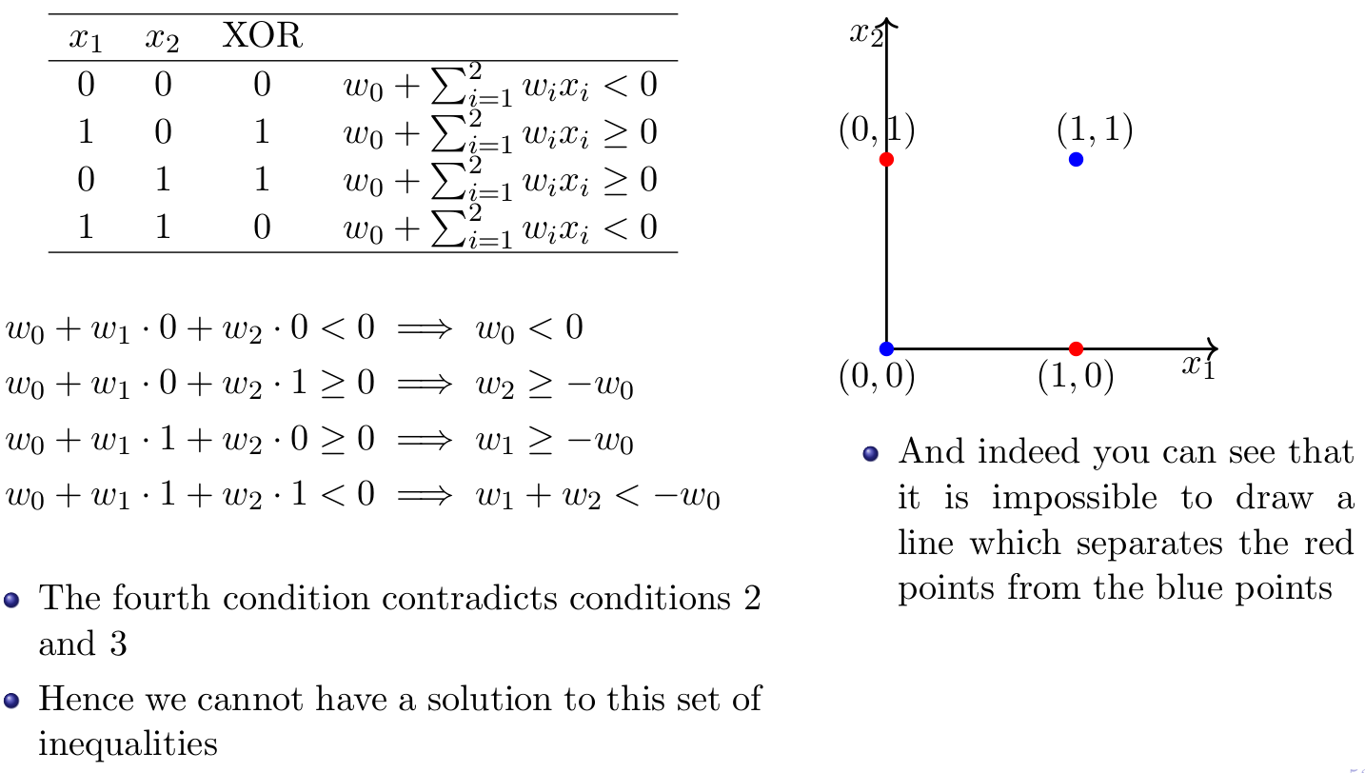
MACHINE INTELLIGENCE
XOR

Slide 15
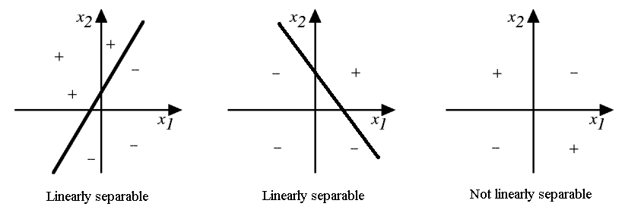
MACHINE INTELLIGENCE
Perceptron fails here
If the data is not linearly separable as in XOR function, then a single perceptron is not enough to represent the functionality.

Slide 16
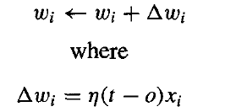
MACHINE INTELLIGENCE
Perceptron Training Rule
x_{i} inputs
w_{i} is the weight related to x_{i}
t is the target output for the current training example
o is the output generated by the perceptron
η is the learning rate, usually set to a small value (say 0.1)
The perceptron learns a linear decision surface of the form
h(x) = w₀ + w₁x₁ + w₂x₂ + w₃x₃ +….

Slide 17
MACHINE INTELLIGENCE
Delta Rule and Gradient Descent
When data is not linearly separable, the perceptron rule may not converge to a proper solution.
The delta rule converges toward a best-fit approximation to the target concept.
Gradient Descent searches the hypothesis space of possible weight vectors to find the weights that best fit the training examples.
We will properly try to explore what is Gradient Descent algorithm

Slide 18
MACHINE INTELLIGENCE
Gradient Descent
let us begin with a function J(θ₀,θ₁)
function ->>>> J(θ₀,θ₁)
required->>>> min_{θ0,θ1} J(θ₀,θ₁)
Steps:
start with some θ₀,θ₁
keep changing θ₀,θ₁ to reduce J(θ₀,θ₁)
do this until you reach minimum

Slide 19
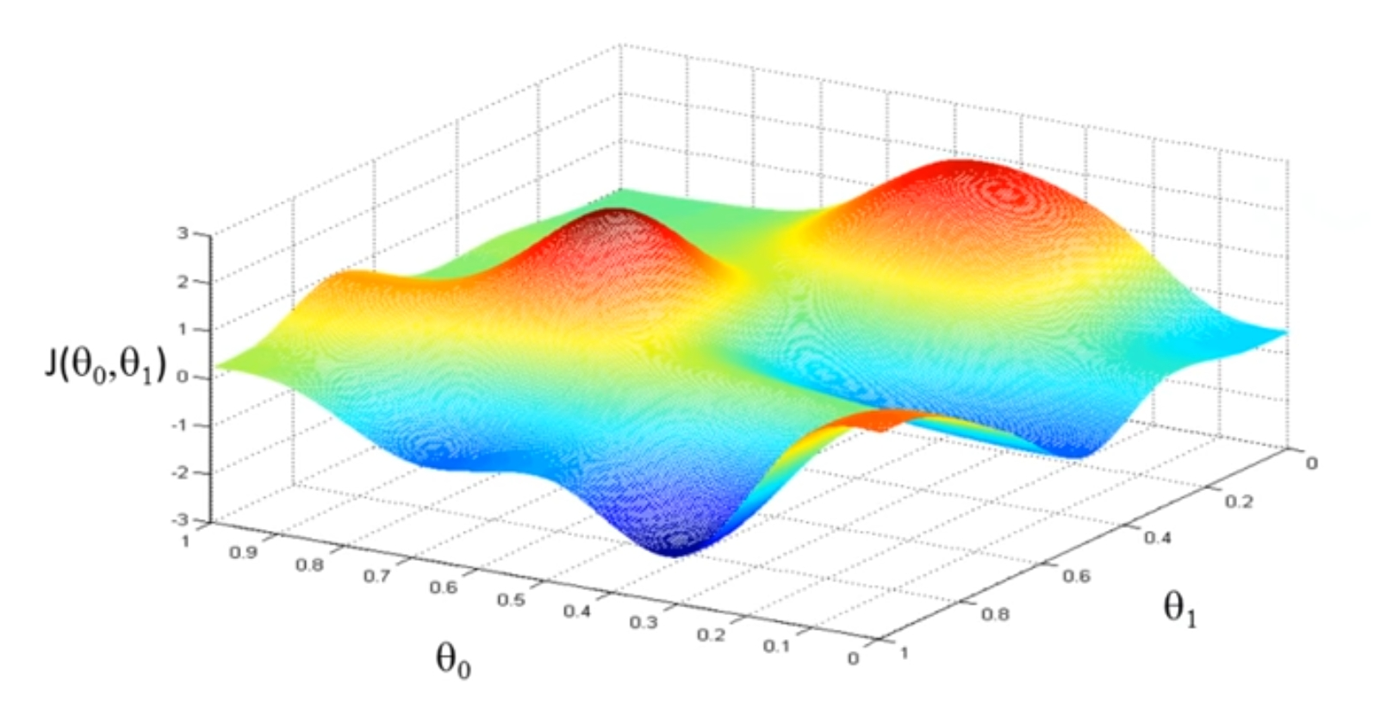
MACHINE INTELLIGENCE
Gradient Descent
let say we are trying to minimize this function
we first start some random J(θ₀,θ₁)

Slide 20
MACHINE INTELLIGENCE
Gradient Descent
imagine the surface as some trekking area and you are standing at that point
in gradient descent what we do is we take a small step in some direction and go down as quickly as possible
the question would be what direction to take the step

Slide 21
MACHINE INTELLIGENCE
Gradient Descent
what you would do is look around and take step
suppose you take a step in the following direction
again in this new point you do the same thing and keep going until you converge to this local minimum

Slide 22
MACHINE INTELLIGENCE
Gradient Descent
now suppose you started with a point just right of our previous initial point
what you would do is again check the steepest descent and proceed in that way
leading you to a second local optimum

Slide 23
MACHINE INTELLIGENCE
Gradient Descent
observe that when start with different starting point we have reached different local minimum
this is one of the property of the gradient descent algorithm

Slide 24
MACHINE INTELLIGENCE
Gradient Descent
this is the algorithm of the gradient descent algorithm
what we do is until convergence we update our parameters of J with the following rule

Slide 25
MACHINE INTELLIGENCE
Gradient Descent
we need to take care of one thing during updating the values
although this algo is valid for j=0,1.n, we will limit our discussion for j=0,1
this wrong since, when you update θ1
you would be using new value of θ0
the correct understanding of algorithm would be

Slide 26
MACHINE INTELLIGENCE
Gradient Descent
The alpha in the algorithm is called the learning rate
this controls hoe bigger step we take downhill
which means if alpha is bigger you take a bigger step down and visa versa
we will later see how to set alpha later

Slide 27
MACHINE INTELLIGENCE
Gradient Descent
consider this function J(x)
we will start our algorithm and initialize our x to some value say a
next step in our algorithm is to update our x according to the below equation
the derivative term is nothing but the slope of the tangent at that point on the curve
J(x)
a
x

Slide 28
MACHINE INTELLIGENCE
Gradient Descent
this line now has a positive slope and hence it has a positive derivative
so our update of x will be
we end moving our x to the left,and it is right since its in the direction of the minimum
and gradient descent seems to be doing well since its making us move in the direction of minimum
J(x)
a
x

Slide 29
MACHINE INTELLIGENCE
Gradient Descent
now let us begin again with initializing x at point b
the slope of the tangent here is negative and hence our derivative term is negative too
our x updation would be
we end um moving right side which is again towards our minimum
hence gradient descent is been doing well till now
J(x)
a
x

Slide 30
MACHINE INTELLIGENCE
Gradient Descent
now let us see what role does alpha play
suppose we keep our alpha too small
lets say we start a point x'
if alpha is too small on each updation we are changing our x with some small value i.e taking small steps
and again from new point we take again small steps to get to minimum
so if alpha is small gradient descent can be slow to reach minimum
J(x)
x
J(x)
x

Slide 31
MACHINE INTELLIGENCE
Gradient Descent
if alpha is too large then gradient may overshoot to minimum or may never reach minimum
suppose we start at point x''
if alpha is too large we are taking a huge step
say we take this step and reach at new point
on next updation we take a huge step and go the right far then the minimum
this may continue and we may never end up reaching minimum
J(x)
x
J(x)
x

Slide 32
MACHINE INTELLIGENCE
Gradient Descent
now suppose our x is already at local minimum what would a gradient descent step do?
at local minimum the slope would be zero
and hence the derivative term is zero
and hence it leaves our x unchanged
this is the one problem with the gradient discent ,i.e you may get stuck in local minimum instead of global minimum
J(x)

Slide 33

MACHINE INTELLIGENCE
Gradient Descent in optimizing perceptron learning
Let us define a error function for our perceptron learning
E is the function of w ,i,e our weights
Let us consider two input perceptron
let x1,and x2 be the inputs and w_{0,}w_{1,}w₂ be bias and weights
we represent W=w₀+w₁*x₁+w₂*x₂
E(w⃗) is the error in the output. We use the square of the error mainly for ease of differentiation.
t_{d} is the training output (expected) for the current data row.
o_{d} is the actual output of the perceptron for the “current” choice of weights.

Slide 34
MACHINE INTELLIGENCE
Gradient Descent in optimizing perceptron learning
Let us define a error function for our perceptron learning
E is the function of w ,i,e our weights
Let us consider two input perceptron
let x1,and x2 be the inputs and w_{0,}w_{1,}w₂ be bias and weights
we represent W=w₀+w₁*x₁+w₂*x₂
we will use gradient descent to move to minimum of our error function updating value of w_{0,}w_{1,}w₂ using the update rule
thus we will reach minimum of the error function and end up finding optimal value for w_{0,}w_{1,}w₂

Slide 35
THANK YOU
K.S.Srinivas
srinivasks@pes.edu
+91 80 2672 1983 Extn 701

